Slide 1
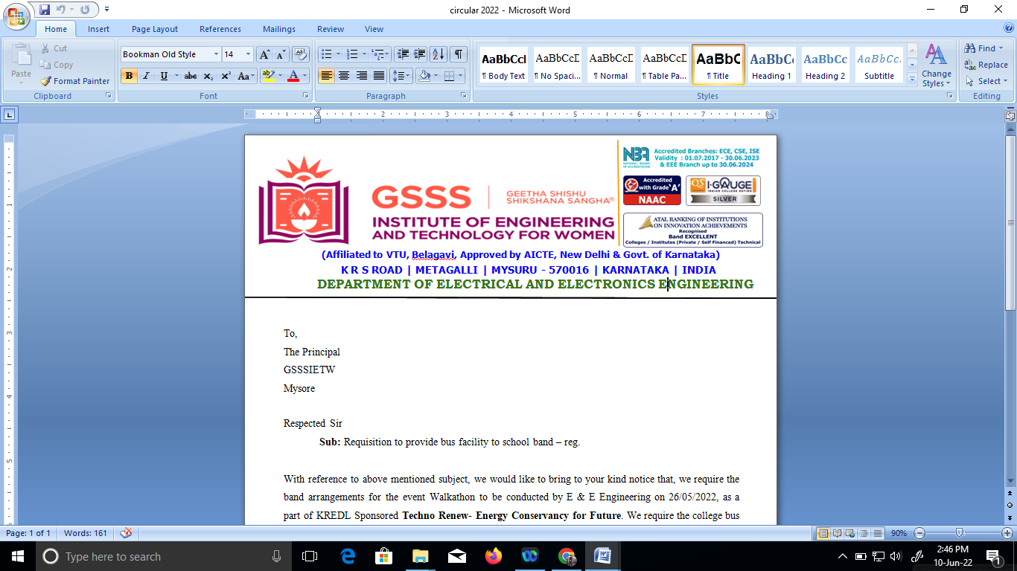

PESTICIDE SPRINKLER WITH IOT BASED SECURITY (Phase 2)
[18EEP78]
by
Bhoomika C P 4GW19EE005
Prakruthi K N 4GW19EE026
Rakshitha G 4GW19EE030
Vidyashree K 4GW19EE041
Under the Guidance of
Smt. SHILPASHRI V N
Assistant Professor
Dept. of EEE, GSSSIETW, Mysuru
Department of Electrical & Electronics Engineering
PRESENTATION ON

Slide 2
Overview
Introduction
Literature survey
Scope of project
Objectives
Methodology
Hardware & Software Description
Expected Outcome
References

Slide 3
Introduction
India is the farmland with a population of 3/4 in agriculture. In accordance with the climate and other resources accessible to them, farmers will grow multiple plants in their field.
Some technological assistance are required to achieve high output and excellent quality. The increase in the demand of labour in the agriculture fields is increasing day by day as the people now a days are less interested in agriculture so all we need is a robot which can replace humans.
Pesticide spraying plays a key role in protecting the field. Many people are not interested in spraying pesticides as they are getting harmful skin infections and breathing problems also carbon dioxide emitted as pollutant during the operation of such pumps has a harmful effect in the environment.
Another important factor is human error which leads to unexpected issues while spraying. For instance, Due to lack of awareness human labour may spray extra dosage to the plants that leads severe damage to the field

Slide 4
Literature Review

Slide 5
Microcontroller Based Security System With Intruder Position – The microcontroller based security system with Intruder Position Display is a design , that applies automated security system. The sensors will receive the signal when the intruder is around , while the control program will translate the received signal from sensor to useful information about function of the system.

Slide 6
Scope of Project
Fast operation because RISC architecture embedded chip is used.
Used in farms and fields.
Maintain public properties and parks.
This Agribot can be a multi-functional device used in sanitizing without personal contact.
Provides Agricultural security.

Slide 7
Objectives
To spray pesticides effectively on the land by sitting at one place.
To monitor the moisture content of the soil.
To speed up the pesticides spraying operation.

Slide 8
Methodology
The robot is placed in the farm and is switched on through IOT and its direction controlled by Android application.
The spraying of pesticides which can be done with the help of pesticide sprinkling pump and is periodically sprayed whenever the relay switch is on.
The system focused on the design, development and the fabrication of the agricultural robot with pesticide spraying system in addition to security system using IOT.

Slide 9
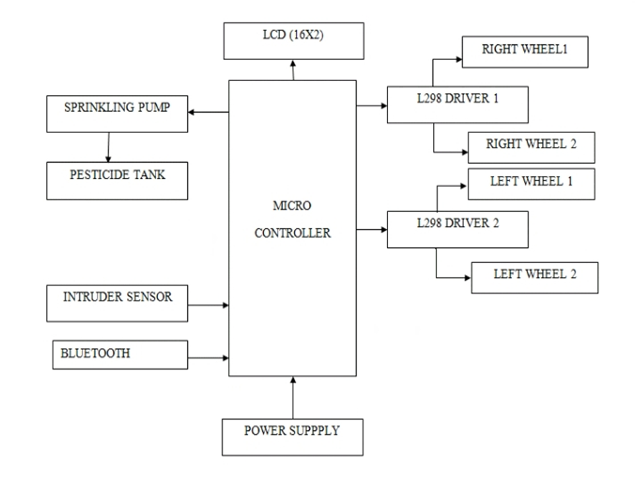
Block Diagram

Slide 10
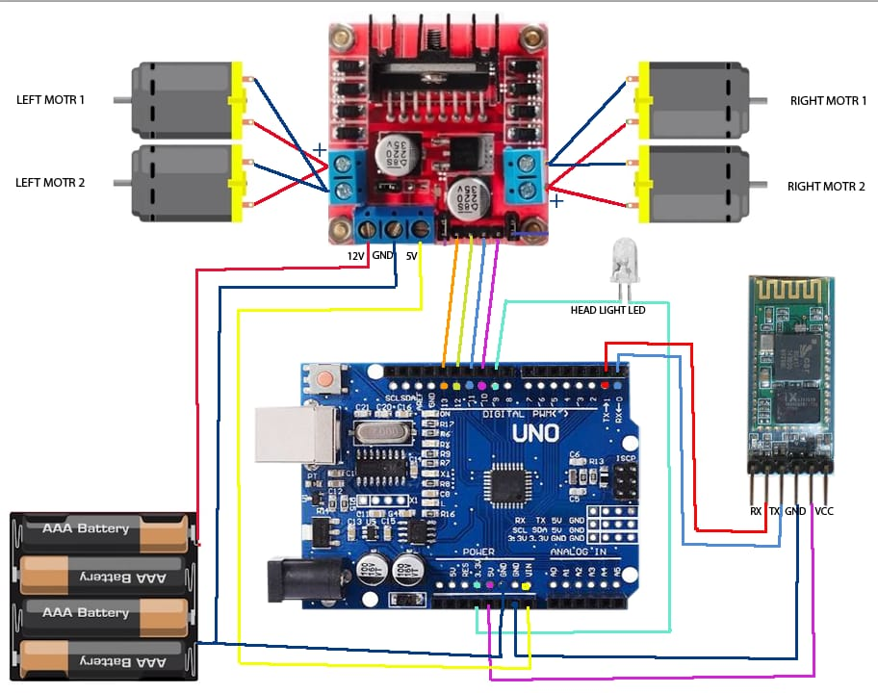

Slide 11
Hardware & Software Description
HARDWARE COMPONENTS
Microcontroller - A microcontroller (MCU for microcontroller unit) is a small computer on a single VLSI integrated circuit (IC) chip.
Pesticide Sprinkler - Sprayers convert a pesticide formulation, which can be large rain-type drops or tiny almost-invisible particles.
Pesticide Tank - The container that contains the mixture of water or another liquid chemical carrier, such as fertilizer and chemical which has to be applied on the crops.
DC Driving Motors - The DC motor drive is a type of amplifier or power modulator that integrate between the controller and a DC motor.
Intruder sensor - Intrusion sensors are meant to determine whether an unauthorized person has accessed, or attempted to access, a protected area.

Slide 12
LCD display - LCD (Liquid Crystal Display) is a type of flat panel display which uses liquid crystals in its primary form of operation.
DC Motors(1000RPM- 12volts) - A DC motor is any of a class of rotary electrical motors that converts direct current (DC) electrical energy into mechanical energy. The most common types rely on the forces produced by magnetic fields.
Bluetooth - A standard for the short-range wireless interconnection of mobile phones, computers, and other electronic devices.
Power supply - A power supply is an electrical device that supplies electric power to an electrical load.

Slide 13
SOFTWARE COMPONENTS
Arduino IDE - The Arduino Integrated Development Environment - or Arduino Software (IDE) - contains a text editor for writing code, a message area, a text console, a toolbar with buttons for common functions and a series of menus.
Embedded C - Embedded C is an extension of C language and it is used to develop micro-controller based applications. The extensions in the Embedded C language from normal C Programming Language is the I/O Hardware Addressing, fixed-point arithmetic operations, accessing address spaces, etc.

Slide 14
EXPECTED OUTCOME
The constructed pesticide sprayer can travel on rough surfaces in the field and sustain enough load of other equipments.
To decrease the work load on the farmers and the severe health problems faced by them .
To use the advanced technology to overcome the disadvantages in the present agricultural system.

Slide 15
REFERENCE
Tahesin Attar, Prajakta Chavan, Vidhi Patel, Megha Gupta, Debajyoti Mukhopadhyay, “An Attempt to Develop an IOT based Vehicle Security System” , 2018, IEEE International Symposium on Smart Electronic Systems (iSES) (Formerly iNiS).
Shahajada Mahmudul Hasan, Syed Mamun R Rasid, Avijit Mallik, Md. Rokunuzzaman, “Development of a Wireless Surveillance Robot for Controlling from Long Distance”, International Journal of Engineering Research and Management(IJERM), ISSN: 2349- 2058, Volume-05, Issue-09, September 2018.
Mr. V. Gowrishankar, Dr. K. Venkatachalam, “GRD Journals- Global Research and Development Journal for Engineering”, Volume 3, Issue 5, April 2018.
Prathibha S R, Anupama Hongal, Jyothi M P, “IOT Based Monitoring System in Smart Agriculture”, 2017, International Conference on Recent Advances in Electronics and Communication Technology.
Priyanka Yadav, Leena Chaudhari, Swati Gawhale, “War Field Spying Robot with Wireless Night Vision Camera”, International Journal for Research in Applied Science & Engineering Technology(IJRASET), 2017.

Slide 16
S Mahendra Kumar and T Guna Sekar, “Cross-Layer Design for Energy Efficient Multicast Video Transmission over Mobile Ad Hoc Networks”, Asian Journal of Research in Social Sciences and Humanities, Volume 6, Issue 9, Pages 719-734, 2016
V Gowrishankar, K Venkatachalam, “Survey on Performance Analysis of Data Converters for Sensor Network Applications”, Vol. 6, Issue 8, 2016.
H. L. Kushwaha, J. P. Sinha, T. K. Khura, Dilip Kumar Kushwaha, Uttpal Ekka, Mayank Purushottam and Nishtha Singh ,“Status and Scope of Robotics in Agriculture”, International Conference on Emerging Technologies in Agricultural and Food Engineering ,30th December, 2016.
Ashish Lalwani, mrunmai Bhide, S. K. Shah, “ A Review:Autonomous Agribot for Smart Farming”, 46th IRF International Conference, 2015.
Parameshachari B D et. Al Optimized Neighbor Discovery in Internet of Things (IoT), 2017 International Conference on Electrical, Electronics, Communication, Computer and Optimization Techniques (ICEECCOT), PP 594-598, 978- 1-5386-2361-9/17/$31.00 ©2017 IEEE.

Slide 17


